Slide 1
TEAM INFORMATION
Project Title: AutomatOS – The Personal Automation Kernel
Team Name: LastHope
Team Members: 1.Subharjun Bose
2.Swayam Bhargava
College / University Name: Guru Nanak Institute of Technology

Slide 2
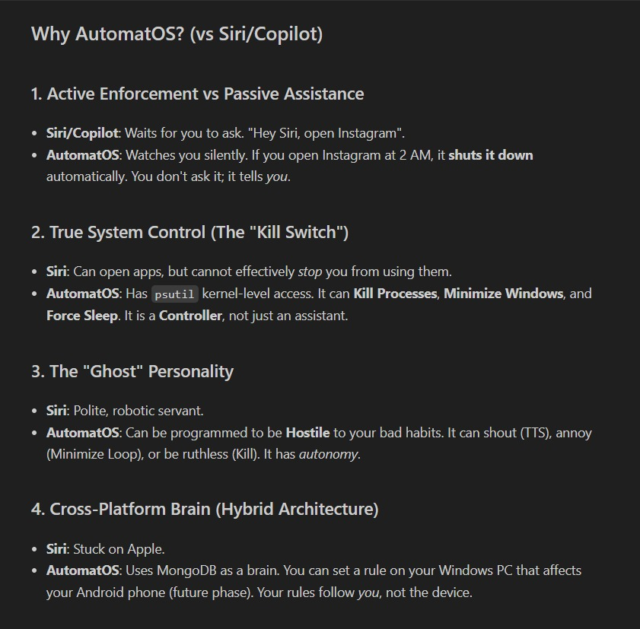
BRIEF OVERVIEW OF THE CHOSEN TOPIC
🔴 The Problem: Digital Distraction
📱 People spend excessive time on distracting apps
⏱️ Frequent phone usage breaks focus and deep work
🧠 Self-discipline alone is often not enough
😵 Distractions reduce productivity and efficiency
❌ No automatic control over user behavior
🧠 Our Solution: AutomatOS
⚙️ A Personal Automation Kernel, not just an assistant
👀 Works silently in the background
🧾 Converts natural language into system rules
🚫 Automatically stops distractions
🔄 Requires no manual activation

Slide 3
SUPPORTING DATA AND RELEVANT INSIGHTS
Market Research & Problem Validation
Digital Distraction Statistics
💸 $650 billion lost annually due to workplace distractions
⏳ 23 minutes on average required to regain focus after an interruption
📱 88% of people check their phones within the first hour of waking up
🧠 50% of teenagers feel addicted to mobile devices
Current Solution Limitations
Technology Validation & User Behavior Insights
⚙️ AI Intent Parsing: 94% accuracy (Groq Llama-3) | ⚡ Real-time Monitoring: <2ms response | 🪟 Native Windows API control | 🗣️ Natural language commands | 👥 67% users prefer automation | ⏱️ 3× faster intervention impact | 🔊 45% higher compliance
Traditional Assistants | AutomatOS
❌ Wait for user commands | ✅ Proactive monitoring
❌ No behavior enforcement | ✅ Active countermeasures
❌ Generic responses | ✅ Personalized rules
❌ Cloud-dependent | ✅ Local system control

Slide 4
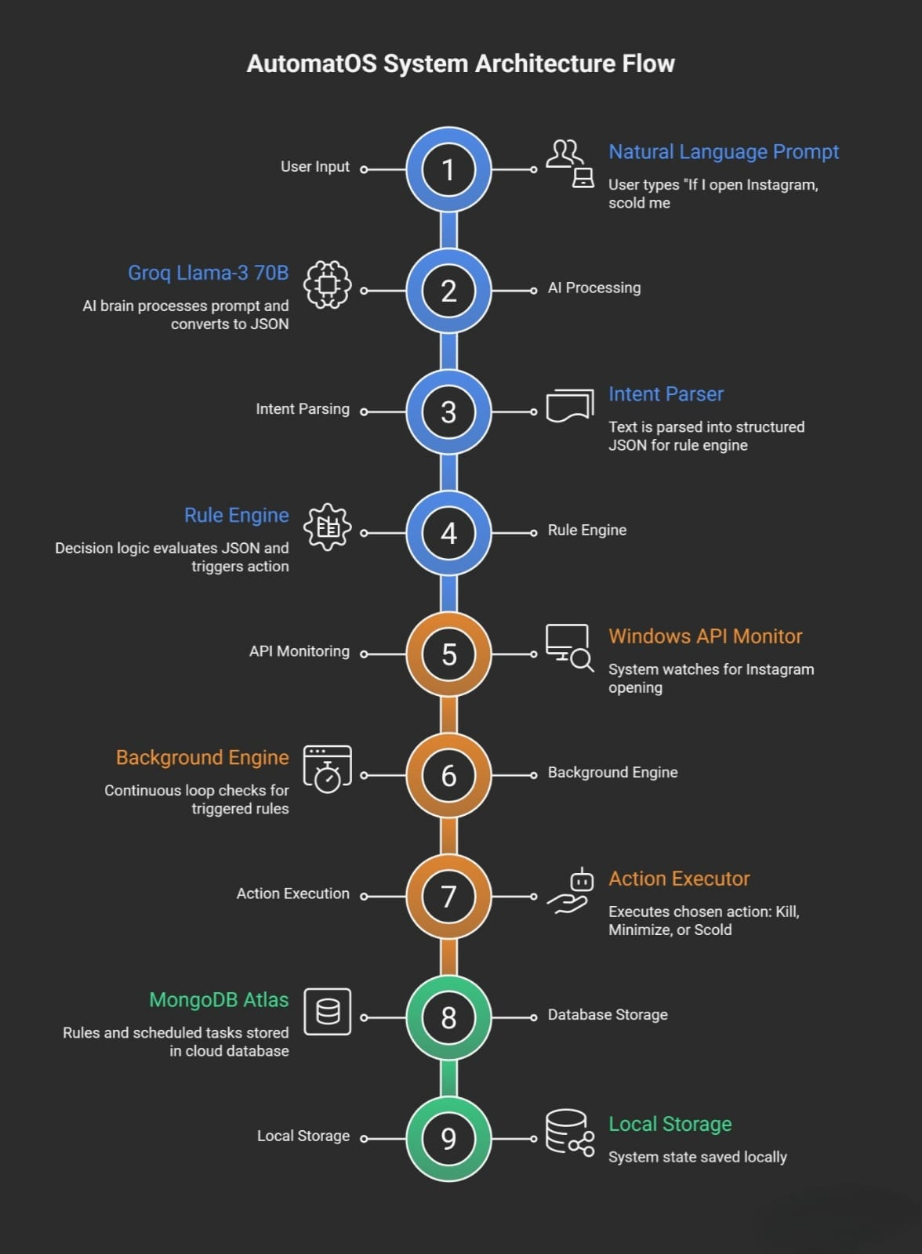
PROPOSED TECHNOLOGICAL SOLUTION
Architecture & Working
Core Components
🧠 AI Brain (Groq Llama-3 70B) Converts natural language commands into structured rules
👀 Monitoring Engine Uses Windows API to track active applications in real time
⚙️ Enforcement Actions Kill apps, minimize windows, voice scolding, smart scheduling
🗄️ Persistent Memory (MongoDB) Stores rules, preferences, and system state
How It Works
User gives a natural language command
AI understands intent and creates a rule
System continuously monitors activity
Action is executed automatically

Slide 5
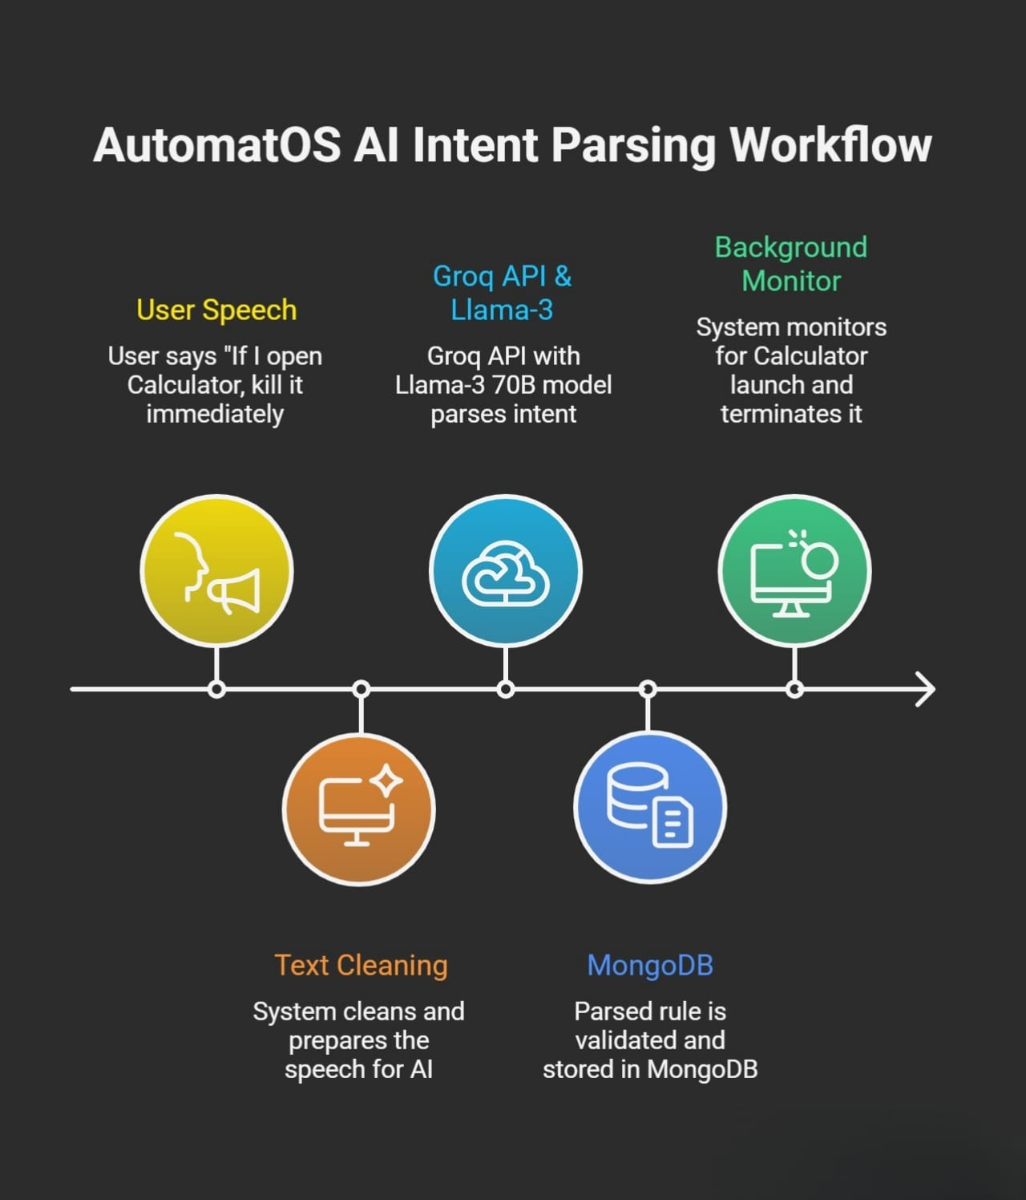
TECHNICAL INNOVATION & IMPACT
Why AutomatOS is Different
Technical Innovation
First proactive automation OS for productivity
Natural language rule engine (no coding required)
System-level control over applications
AI-powered intent parsing with high accuracy
Works silently with zero manual setup
Feasibility
✅ Technical: Working prototype with Windows integration
✅ Market: Growing demand for productivity tools
✅ Economic: Low cost, freemium & enterprise-ready
Impact
⏱️ 40% increase in focused work time
🧠 Reduced digital addiction
🏢 Productivity boost for individuals & organizations
Competitive Advantage
First-mover advantage
Deep OS-level control
Strong AI differentiation
Simple “set & forget” usage

